Slide 1
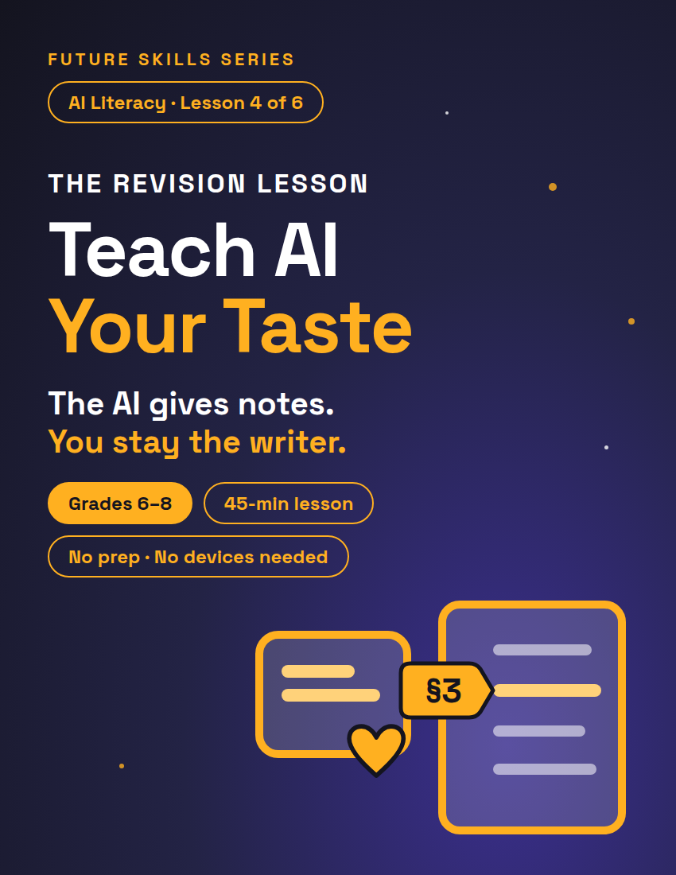
FUTURE SKILLS · AI LITERACY
THE REVISION LESSON
Teach AI Your Taste
Your For-You Page didn't guess your taste — you taught it, one like at a time. Today you write your taste down on one page, then use it to make YOUR OWN writing better.
1 / 13
Notes:
Open on this slide while students settle. Worksheet: My Taste File, The Editor's Chair, and Revise & Last Check, 3 pages, one per student. The deck follows the lesson plan block for block; the minute chips top-right match it.

Slide 2
FUTURE SKILLS · AI LITERACY
6 MIN
Warm-Up — The Algorithm Knows You
Raise your hand if your feed knows you a little too well.
Two people download the same app on the same day.
A month later: one feed is all horror edits, the other is all cooking videos.
The app didn't guess. How did it learn?
2 / 13
Notes:
Any feed counts: YouTube, a music app, even a game store's "recommended" row. Take 2–3 answers. Land on: every like, skip, rewatch, and follow is a signal. Nobody guessed. You taught it. Your feed is your taste, written down in likes and skips. WHAT IF a student says 'my feed is random': "Random is a signal too. What do you skip in the first second? That's a like in reverse." Nobody raises a hand? Name your own feed first.

Slide 3
FUTURE SKILLS · AI LITERACY
Here's the other side
?
An AI doesn't know your taste unless you tell it, or it has saved notes about you. So what do you hand it?
3 / 13
Notes:
ANSWER (say it, don't show it): your taste, written down. You teach it, the same way you taught the feed. Bridge, verbatim: "Here's the other side. An AI doesn't know your taste unless you tell it, or it has saved notes about you. Today you write yours down on one page, then use it to make YOUR OWN writing better." TRANSITION: "So what happens when your editor knows nothing about you? Let's see."

Slide 4
FUTURE SKILLS · AI LITERACY
6 MIN
Generic In, Generic Out
1
2
3
Generic in, generic out
The Taste File
The editor loop
Ask "give me feedback on my paragraph" and you usually get notes for a generic writer: "add detail." True for anyone, useful to no one.
One page: your tone, formats, pet peeves, one "so me" sentence. Hand it to any editor and the notes finally fit YOU.
YOU draft → editor gives notes → YOU revise. The human does the writing at both ends.
4 / 13
Notes:
Three beats, in order. Beat 2, if your class did Lesson 1, How to Talk to AI: the taste file is the R in P.R.O., written down once. Beat 3: say it plainly, once. "AI is your editor, not your ghostwriter." Then advance: which note could you use?

Slide 5
FUTURE SKILLS · AI LITERACY
Which note could you use?
Draft: watch sentence 2
Generic note
Taste-file note
1. "Hello and welcome to my channel!"
2. "I enjoy various hobbies such as gaming and cooking."
3. "I upload content on a regular basis."
"Make it more interesting."
"Section 1 says funny and blunt — sentence 2 sounds like a homework robot. Say it like you'd text a friend."
5 / 13
Notes:
Read the draft aloud first, then both notes. Ask: which one could you actually act on? The generic note fits any writer. The taste-file note names a section AND a sentence. That's the whole difference. WHAT IF 'the AI I use already knows me': "Some tools save notes about you. A fresh chat usually doesn't. Either way, the file makes sure the notes fit."

Slide 6
FUTURE SKILLS · AI LITERACY
“
AI is your editor, not your ghostwriter.
An editor gives notes on YOUR writing. A ghostwriter writes it for you.
6 / 13
Notes:
Say it once: a ghostwriter writes it for you and lets you put your name on it. Today nobody in this room is a ghostwriter, not a partner and not an AI. Then move on. TRANSITION: "Page 1. Your taste, written down — five sections, ten minutes, solo. Nobody swaps yet."

Slide 7
FUTURE SKILLS · AI LITERACY
10 MIN
Activity 1 — Build Your Taste File
Section 1 — The Vibe: check the 3 tone words that sound like you, add one of your own.
Section 2 — How I Like It: check every format you actually enjoy reading.
Section 3 — Pet Peeves: "Editor, never ______." Write two.
Section 4 — So Me / Not Me: your weekend in your voice, then as a robot, a textbook, or a fancy poet.
Section 5 — What I'm Into Right Now: music, shows, and games. Give the feel, not the name.
7 / 13
Notes:
Solo on worksheet page 1. Circulate and push for specifics: "quiet" beats "good"; "don't make me sound like a textbook" beats "be nice." WHAT IF stuck on So Me: "Read me the last text you sent a friend. That's your voice." Still stuck? Read Jaylen's pair aloud: "Saturday I made the world's saddest pancake and ate it anyway." / "On Saturday I prepared a breakfast item that did not meet expectations." Minute 8: two volunteers read a So Me sentence, so the class hears how different real taste sounds. TRANSITION: "Flip to page 2. Three to four sentences: the About Me for a channel or profile you'd really make. Match your taste file. Solo — five minutes."

Slide 8
FUTURE SKILLS · AI LITERACY
18 MIN
Activity 2 — The Editor's Chair
1
Draft it yourself · 5 min
Solo, page 2, Step 1. 3–4 sentences: the About Me for a channel or profile you'd really make. No AI, no partner.
2
Editor's notes · 7 min
Swap ALL pages. Read THEIR taste file, then write 2 notes on THEIR page 2 — each names a section. No rewriting. Then talk for 2 minutes.
3
Revise it yourself · 6 min
Copy your draft onto page 3. Change only the sentences your notes point at, plus any word that has to change with them. Star (*) every change.
8 / 13
Notes:
DRAFT — WHAT IF 'I don't have a channel': "The one you WOULD make — a game name, a team, a club, a pet's account." TRANSITION: "Pens down. Swap ALL your pages with your partner. You're their editor now — and page 1 is the only thing you're allowed to know about them." NOTES, by the clock: 0:00 swap (30 s) · 0:30 write 2 notes (4 min; put the next slide up) · 4:30 read the turn order aloud, Speaker 1's minute · 5:30 Speaker 2's minute · 6:30 swap back (30 s). WHAT IF the editor rewrites: "You're the editor. Hand the pen back." No section number: "Which section? No section, no note." Typing? Partners swap Chromebooks, not sheets; notes go in the Note 1 and Note 2 fields. With devices: run Step 2 once on YOUR projected account, with one volunteer's taste file and draft in the copy-ready prompt (Teacher Guide). The class checks that each note names a section. Students never need an account. TRANSITION at 4:30: "Pens down. Speaker 1, you're the editor first. Writers, one question." At 5:30: "Switch. Speaker 2, you're the editor now." At 6:30: "Swap back. Page 3 — your draft, your pen. Star every change." REVISE: read the Step 3 line aloud, word for word.

Slide 9
FUTURE SKILLS · AI LITERACY
What a good note looks like
WRITES IT FOR YOU (REJECT)
EDITOR'S NOTE (ACCEPT)
"Make it funnier. Say: 'Welcome to my chaotic channel!'"
"Section 3 says no textbook voice — 'I enjoy various hobbies' is textbook voice. Which hobby, said your way?"
9 / 13
Notes:
Leave this up while editors write. Three rules: use only the taste file, exactly 2 notes, notes not rewrites. The second the editor writes a sentence, they've become a ghostwriter. A second pair for the board if needed. Reject: "It's good. Maybe add more." Accept: "Section 2 says short and punchy — sentence 3 is 22 words. Which half matters?"

Slide 10
FUTURE SKILLS · AI LITERACY
Talk it through — 2 minutes
Speaker 1 is the partner whose first name comes first in the alphabet.
Speaker 1 is the editor for the first minute: read your two notes out loud.
Writer: ask ONE question.
Editor: answer from THEIR taste file — never your own taste.
Then switch: Speaker 2 is the editor for minute two.
Then swap sheets back.
10 / 13
Notes:
This is the SL.6.1 moment, and the turn order is what makes it one: every student reads notes aloud AND asks a question. The same text is printed on worksheet page 2, with the two question frames: "Which sentence?" or "What would fit?" Sample 3–4 pairs. Listen for an answer that cites a section ("Section 3 says no textbook voice"), not the editor's own taste ("I'd just make it funnier"). WHAT IF two partners have the same first letter: "Check the second letter." Same name? "Whoever sits nearer the door goes first." WHAT IF the writer argues back: "Ask which sentence, not whether." Both check checklist row 4 on page 3 afterwards.

Slide 11
FUTURE SKILLS · AI LITERACY
Editor Loop Checklist
I wrote the first draft myself — no AI, no copying.
My editor's notes each named a section and said what to change, not "make it better."
I made the changes myself and starred every one.
My editor read both notes aloud, I asked one question, and they answered from my taste file.
11 / 13
Notes:
Page 3, after the revision. Students check all four before the Last Check. Rows 1 and 3 check the human at both ends (own draft, own revision; check against the handwriting and the stars). Row 4 checks the talk you sampled. WHAT IF a student changed nothing: "Your editor pointed at Section 3. Read it out loud. Now change one sentence to match it." TRANSITION: "Four checks. Then the Last Check: three answers, your own words, five minutes. Short is fine on #1."

Slide 12
FUTURE SKILLS · AI LITERACY
5 MIN
Last Check — page 3, your own sheet
The one word or phrase you changed (old → new):
The new version fits my taste file because (name the section):
Why would the note "make it better" NOT have helped you?
12 / 13
Notes:
Solo, 5 minutes. Collect. KEY — #1: names one word or phrase and gives it both ways, old → new ("I made it funnier" without the words = redo). #2: names a section and the match: "Section 1 says blunt; the new line is blunt." #3 (Objective 1): proficient = "make it better" names no sentence and no direction (better for whom?), while the real note named a section and a sentence. Jaylen exemplar: #1 "'I enjoy various hobbies such as gaming and cooking' → 'I lose at games and cook worse.'" #2 "Section 3 says no textbook voice; Section 1 says funny and blunt." #3 "'Make it better' doesn't say what's wrong or what better means for ME. The note that named Section 3 told me which sentence and why." WHAT IF "I made it better": "Which word changed? Write the old word and the new one."

Slide 13
FUTURE SKILLS · AI LITERACY
You draft. The editor gives notes. You revise.
A good AI job runs human → AI → human: you draft, the AI gives the notes, you revise. Your feed needed a month of likes to learn you. Your editor needed one page.
13 / 13
Notes:
Close on this. Next in the unit: Robots Do the Boring Work (Lesson 5, sold separately). This lesson stands alone either way.

